Slide 1

NFBT Credit Cards
Marketing Analytics
Adesh Valecha, Sushruti Acharya

Slide 2

Problem
NFBT’s customers are not applying and converting to credit cards
NFBT makes more money from the interest rates on credit cards as compared to debit cards. Therefore, the bank wants to expand the credit card business
Currently, only 5.8% of customers are accepting credit card offers

Slide 3
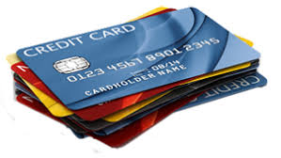
Approach
Logistic regression on whole dataset.
Outcome variable is binary.
Independent Variables | Dependent Variable
Years, amount_spent, Transaction_frequency, Credit_Score | Offer_success

Slide 4

Logistic Regression
Variables ‘Amount_spent’ and ‘years’ are highly significant and have positive impact on offer success
'Transaction_frequency’ is less significant and has a negative impact on dependant variable
‘Credit_score’ is not significant
Coefficients | Estimate | Std. Error | z value | Pr(>|z|)
(Intercept) | -5.32436 | 0.38028 | -14.001 | < 2e-16 ***
Transaction frequency | -0.18213 | 0.09082 | -2.005 | 0.0449 *
Credit score | -0.08852 | 0.05985 | -1.479 | 0.1391
Amount spent | 0.84326 | 0.10134 | 8.321 | < 2e-16 ***
years | 1.18957 | 0.18014 | 6.604 | 4.01e-11 ***

Slide 5
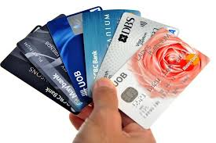
Outliers Detection
Logistic Regression on Inliers and Outliers dataset
Dividing the data using Fast MCD
Inliers and Outliers
Faster and more effective than general purpose techniques
Able to detect exact fit situations
Useful on large datasets
Coefficients | Full Data | Inliers | Outliers
(Intercept) | -5.324 | -6.25 | -3.67
Transaction frequency | -0.182 | 0.129 | -0.220
Credit score | -0.089 | 0.471 | -0.127
Amount spent | 0.843 | 0.846 | 0.595
years | 1.190 | 1.645 | 0.930

Slide 6
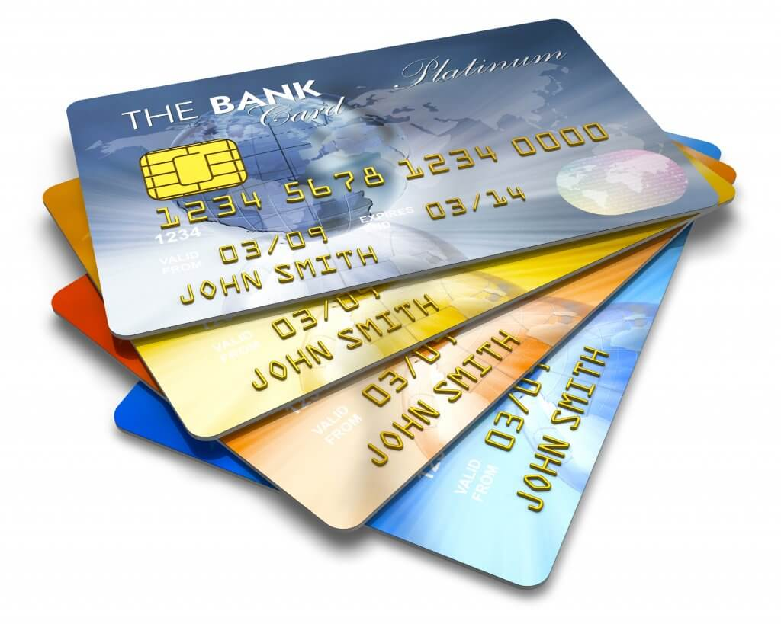
Outlier Analysis
‘Outliers’ are the customers who are more likely to accept a credit card offer
Each variable influences the chance of applying for a NFBT credit card
 | 1006 Inliers | 194 Outliers
Mean Offer Success | 1.1% | 29.9%
Mean Transaction Frequency | 0.033 | 1.952
Mean Amount Spent | 0.025 | 3.961
Mean Credit Score | 0.040 | 3.137
Mean Years | 0.036 | 1.088

Slide 7

Recommendations
Specific suggestions:
Offer credit cards to customers who have reached a threshold for years being with the bank
Offer credit cards to customers with monthly spending above a threshold
Offer credit cards to customers with a credit score above a threshold
Target on marketing efforts and credit card offers on customers same as outlier profile
Higher monthly spending and frequency
Higher credit score
Longer tenure with the bank
Outliers consists of 16% of population but it has 28% higher offer acceptance.

